Slide 1




Summer School of Neurogeriatrics and Dementia
8 July – 3 August 2019
School of Medicine & Health Sciences
Atma Jaya Catholic University of Indonesia
Jl. Pluit Raya no. 2, Jakarta Utara, Indonesia

Slide 2
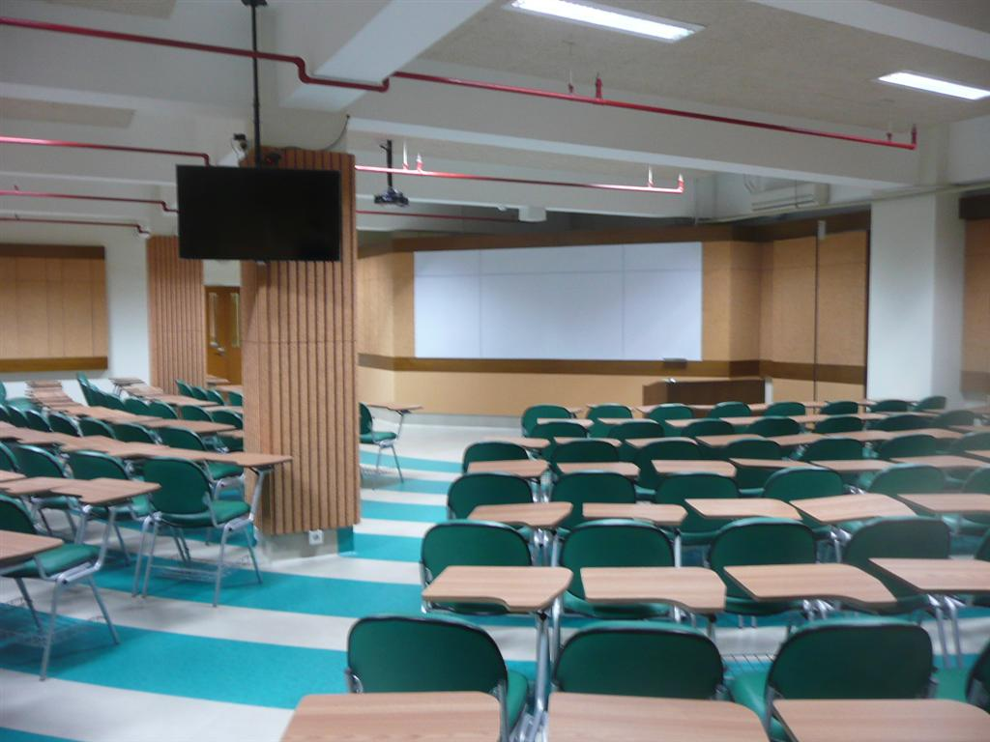
INTRODUCTION
In facing the global ageing population, this programme is designed to bring the participants to delve deeper in the integrative multidiscipline management of geriatrics problems, especially dementia, through a person-centred care approach. After completion, participants are expected to be able to apply logical, critical, systematic, and innovative thinking in implementing knowledge and technology in caring for the people with dementia. Besides learning about assessments in dementia, participants will also look at the issue of dementia from policy, ethics, legal, economics, cultural aspects; and learn about research projects on cognitive function and quality of life of older people in Indonesia.

Slide 3

The Summer School of Neurogeriatrics & Dementia will run for four weeks an will consist of a series of lectures, problem-based learning tutorials, skills labs, and optional field trips, an Indonesian “study buddy” will be assigned to each participant from abroad.
Issues for consideration will include:
  Neuropsychological assessment in older people
  Dementia diagnosis across cultures and languages
  Behaviour & psychological symptoms of dementia: Overcoming challenges
  Engaging people with dementia through effective communication
  Cognitive stimulation therapy
  Ethical, legal, and financial issues in Dementia

Slide 4



Provisional Schedule
(as per 21 December 2018*)
*The schedule may be subject to change under certain circumstances

Slide 5

Week 1
Day 1: Monday, 08 July 2019
08.00 – 08.30 | Introduction
08.30 – 10.20 | Basic Brain Neuroanatomy
10.20 – 10.40 | Comfort break
10.40 – 12.30 | Comprehensive Geriatric Assessment
12.30 – 13.30 | Lunch break
13.30 – 15.30 | Dementia as a Global Health Problem: Alzheimer’s Disease International’s perspective
Day 2: Tuesday, 09 July 2019
08.00 – 10.00 | Brain Changes in Ageing
10.00 – 10.20 | Comfort break
10.20 – 12.30 | Alzheimer’s Disease
12.30 – 13.30 | Lunch break
13.30 – 15.00 | Vascular Cognitive Impairment and its relation to Alzheimer’s
15.00 – 16.30 | Can Dementia be Prevented?

Slide 6
Day 3: Wednesday, 10 July 2019
08.00 – 09.50 | Lewy Body Diseases
09.50 – 10.10 | Comfort break
10.10 – 12.00 | Frontotemporal Dementia
12.00 – 13.30 | Lunch break
13.30 – 15.30 | Raising awareness of dementia in Indonesia: Alzheimer’s Indonesia’s experience
Day 4: Thursday, 11 July 2019
08.30 – 10.20 | Primary Progressive Aphasia
10.20 – 10.40 | Comfort break
10.40 – 12.30 | Problem-based learning 1-1
12.30 – 13.30 | Lunch break
13.30 – 15.30 | Neuropsychological Assessment in Elderly
Day 5: Friday, 12 July 2019
08.00 – 09.50 | Challenges in diagnosis and treatment of neurogeriatric problems
09.50 – 10.10 | Comfort break
10.10 – 12.00 | Skills Lab 1-1: Cognitive Assessments
12.00 – 13.30 | Lunch break
13.30 – 14.30 | Dementia sharing session 1
14.30 – 16.30 | Dementia diagnosis across cultures and languages

Slide 7
Week 2
Day 6: Monday, 15 July 2019
08.30 – 10.20 | Role of Brain Imaging in Dementia Diagnosis
10.20 – 10.40 | Comfort break
10.40 – 12.30 | Problem-based learning 1-2
12.30 – 13.30 | Lunch break
13.30 – 15.30 | Awareness and prevalence of dementia: Highlights from Yogyakarta study
Day 7: Tuesday, 16 July 2019
08.30 – 10.20 | Pharmacological treatment in dementia
10.20 – 10.40 | Comfort break
10.40 – 12.30 | Skills Lab 1-2: Cognitive Assessments
12.30 – 13.30 | Lunch break
13.30 – 15.30 | Physical Activity for Elderly

Slide 8
Day 8: Wednesday, 17 July 2019
08.00 – 09.50 | Polypharmacy in Elderly
09.50 – 10.10 | Comfort break
10.10 – 12.00 | Behavioural and Psychological Symptoms of Dementia (BPSD): A person-centred approach
12.00 – 13.30 | Lunch break
13.30 – 15.30 | BPSD: Pharmacological management
Day 9: Thursday, 18 July 2019
08.30 – 10.20 | Dementia sharing session 2
10.20 – 10.40 | Comfort break
10.40 – 12.30 | Problem-based learning 2-1
12.30 – 13.30 | Lunch break
13.30 – 15.30 | Caregiver Burnout
Day 10: Friday, 19 July 2019:
08.00 – 15.30 | Pain Assessment and Management Workshop Detailed schedule to be announced

Slide 9
Week 3
Day 11: Monday, 22 July 2019
08.30 – 10.20 | Movement problems as fall risk in elderly
10.20 – 10.40 | Comfort break
10.40 – 12.30 | Problem-based learning 2-2
12.30 – 13.30 | Lunch break
13.30 – 15.30 | Dementia sharing session 3: STRiDE project
Day 12: Tuesday, 23 July 2019
08.30 – 10.20 | Falls in Elderly
10.20 – 10.40 | Comfort break
10.40 – 12.30 | Group Activity
12.30 – 13.30 | Lunch break
13.30 – 15.30 | Ethical aspects of dementia

Slide 10
Day 13: Wednesday, 24 July 2019
08.00 – 09.50 | Optimal nutrition for elderly
09.50 – 10.10 | Comfort break
10.10 – 12.00 | Group Activity & Discussion
12.00 – 13.30 | Lunch break
13.30 – 15.30 | Legal issues in dementia
Day 14: Thursday, 25 July 2019
08.30 – 10.20 | Supporting effective communication with people with dementia
10.20 – 10.40 | Comfort break
10.40 – 12.30 | Dementia sharing session 4
12.30 – 13.30 | Lunch break
13.30 – 15.30 | Facilitating elderly group activities
Day 15: Friday, 26 July 2019
08.00 – 09.50 | Empathetic counselling
09.50 – 10.10 | Comfort break
10.10 – 12.00 | Skills Lab 2-1: Communication technique
12.00 – 13.30 | Lunch break
13.30 – 15.30 | Research on elderly population with low level of education: Lessons from Active Ageing Study

Slide 11
Week 4
Day 16: Monday, 29 July 2019
08.30 – 10.20 | Stigma: Lesson from the STRiDE project
10.20 – 10.40 | Comfort break
10.40 – 12.30 | Dementia sharing session 5: People with dementia’s involvement in research and advocacy
12.30 – 13.30 | Lunch break
13.30 – 15.30 | Parallel sessions:
 | A | B
 | Mass media communication: Stigma reduction strategies | Communicating research to the public
Day 17: Tuesday, 30 July 2019
08.30 – 10.20 | Problem-based learning 1&2 plenary session
10.20 – 10.40 | Comfort break
10.40 – 12.30 | Skills lab 2-1: Communication technique
12.30 – 13.30 | Lunch break
13.30 – 15.30 | Group work

Slide 12
Day 18: Wednesday, 31 July 2019:
08.00-15.30 | Long-term care mini-symposium Topics: Palliative care in dementia Role of nursing home in dementia care Long-term care system
Day 19: Thursday, 01 August 2019
08.30 – 15.30 | Cognitive Stimulation Therapy Workshop Detailed schedule to be announced
Day 20: Friday, 02 August 2019
08.00 – 09.50 | Dementia Friendly Community Initiatives: It starts from us
09.50 – 10.10 | Comfort break
10.10 – 11.45 | Group presentation 1
11.45 – 13.30 | Lunch break
13.30 – 15.00 | Group presentation 2
15.00 – 15.30 | Closing

Slide 13

Week 5-10
For international participants: up to 6 weeks optional extension to join ongoing research in elderly in Indonesia

Slide 14

Supporting documents:
CV
Motivation letter, starting:
  Why you want to join this programme
  What particulary attracts you to the chosen programme
  How do your academic and professional background and skills meet the demands of this programme?
  How this programme will impatct your work/future career plan
Most recent official Transcript of Records

Slide 15

Director
Octavianus Darmawan, M.D, M.Biomed (Neurologist)
Co-Director
Tara P. Sani, M.D, M.Sc (Dementia)
Language of instruction
English (main), Indonesian (several class)

Slide 16




Come and Join Us
USD 300
tara.sani@atmajaya.ac.id
+62 83872601101 (Ika)

Slide 17

Dementia Program activitIES
Atma Jaya

Slide 18
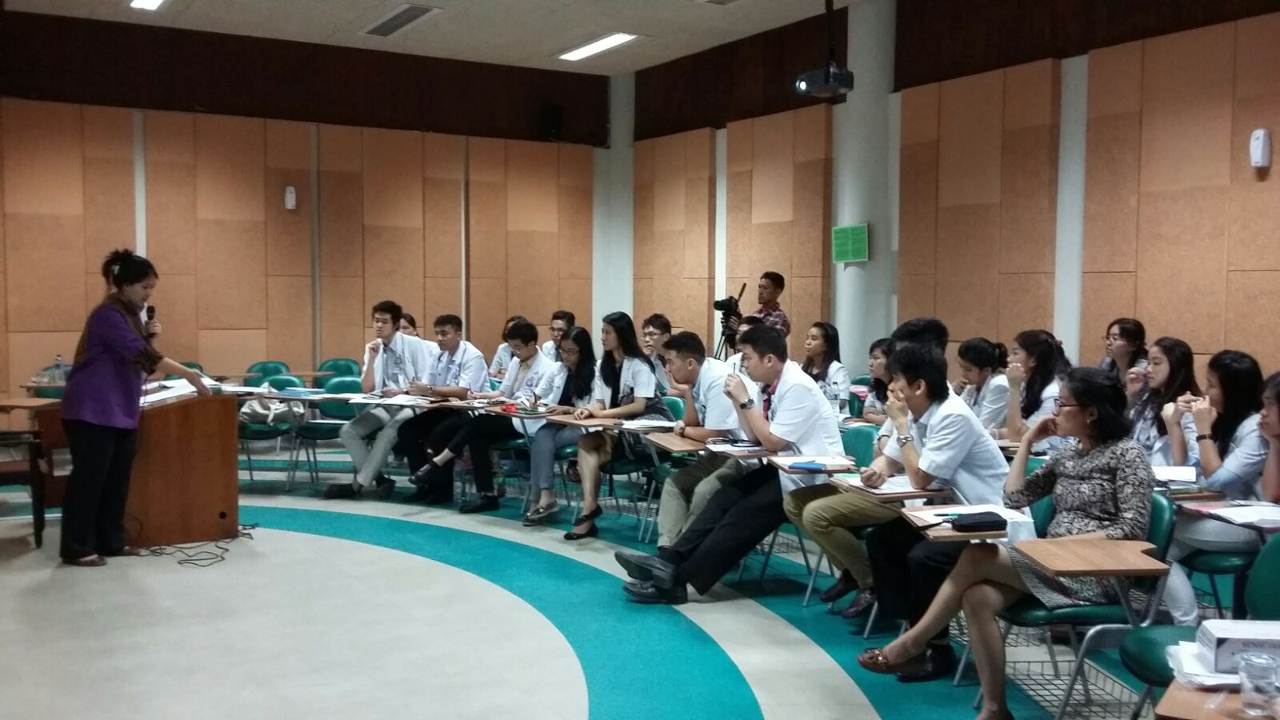

Slide 19
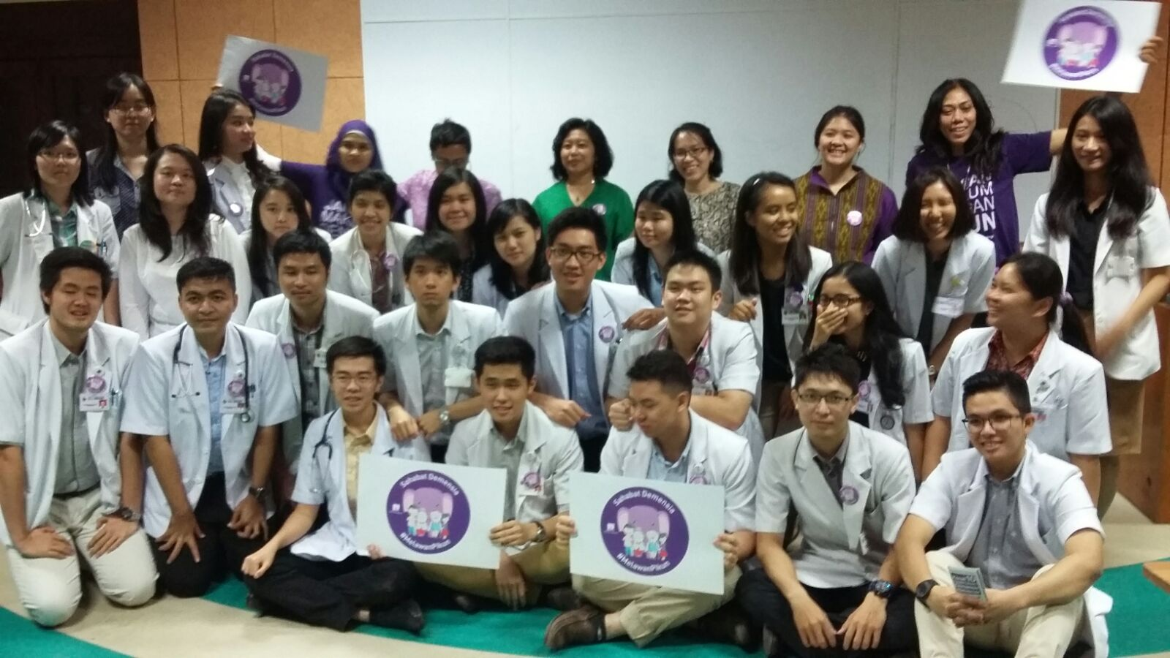

Slide 20
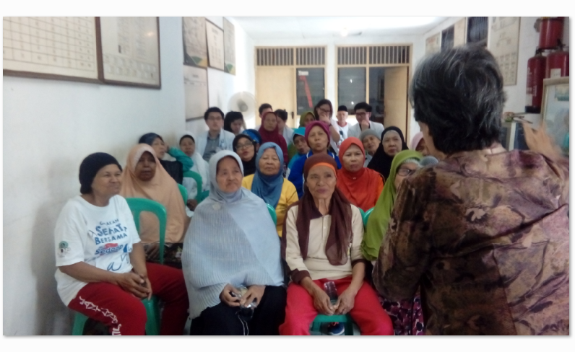

Slide 21
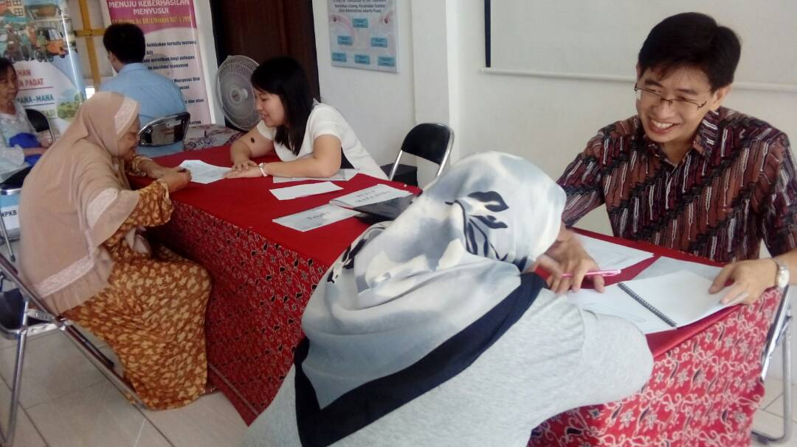

Slide 22
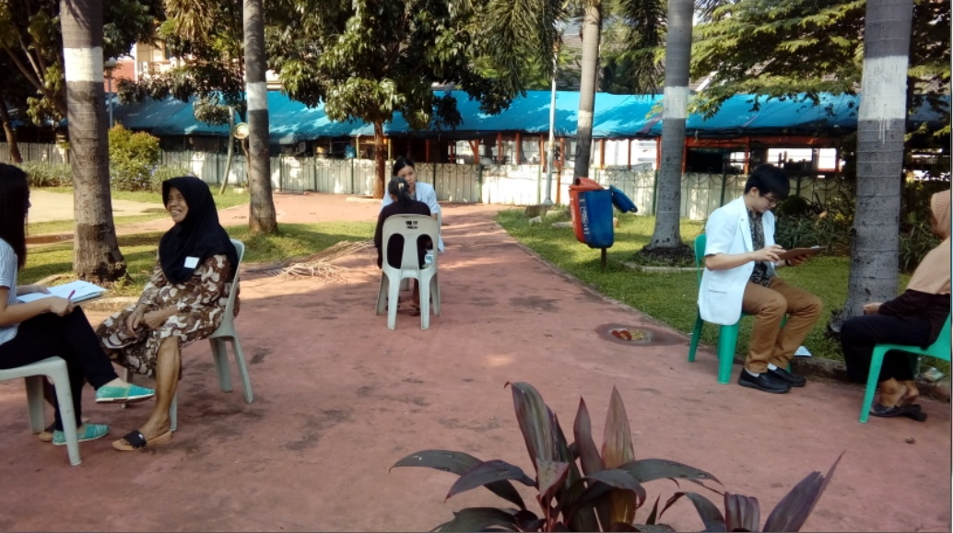

Slide 23
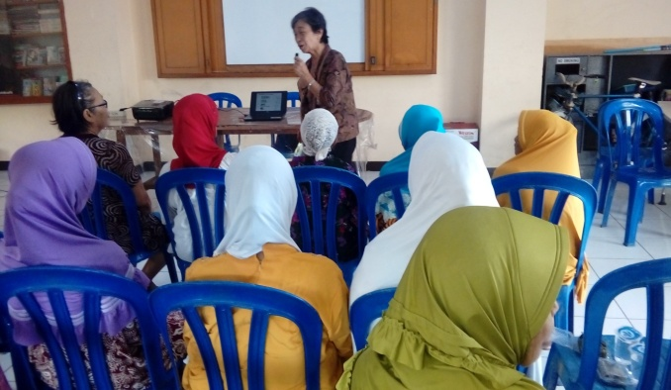

Slide 24
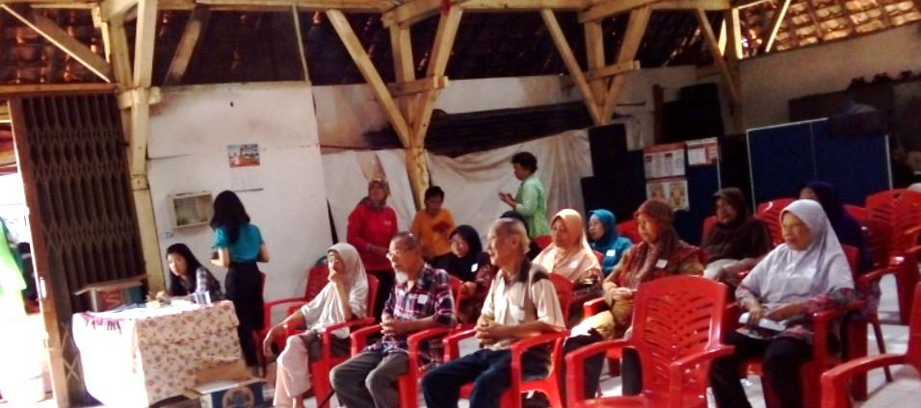
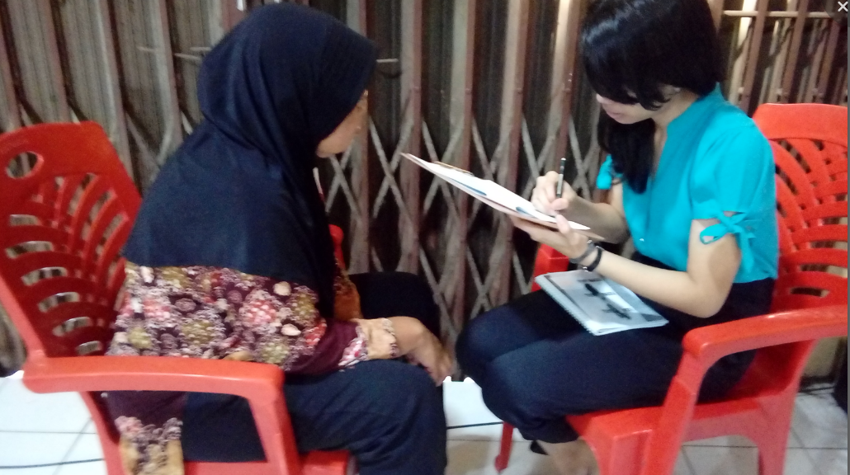

Slide 25
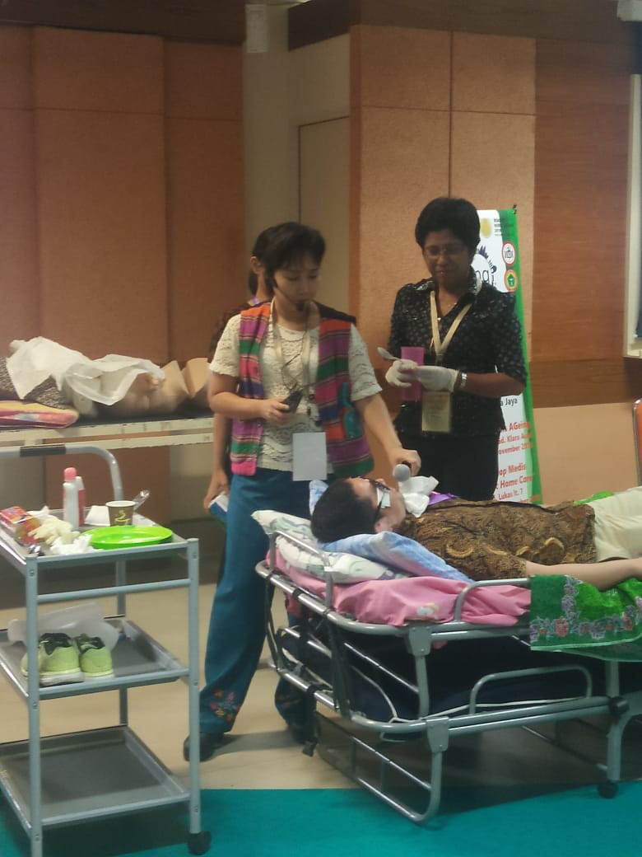
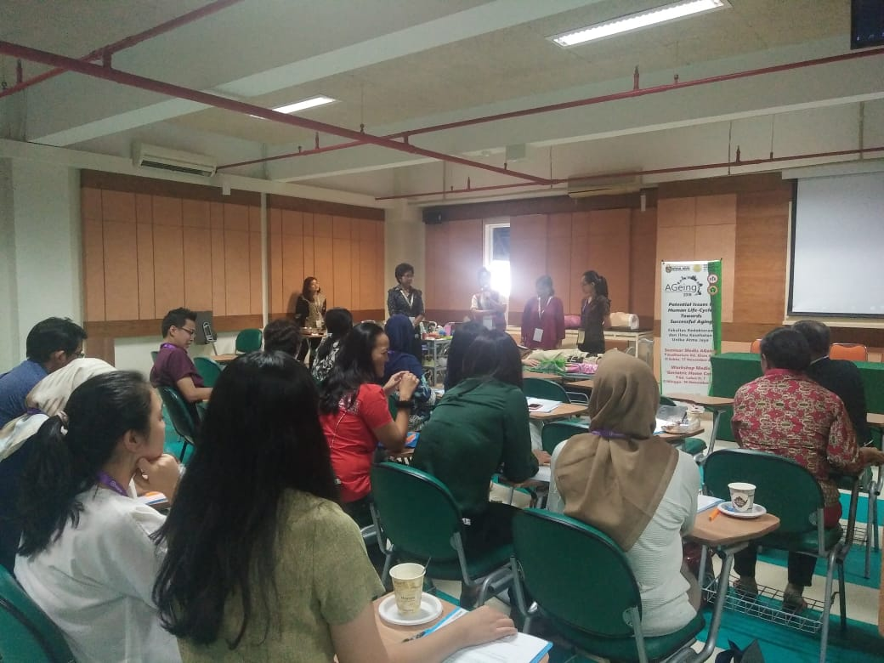
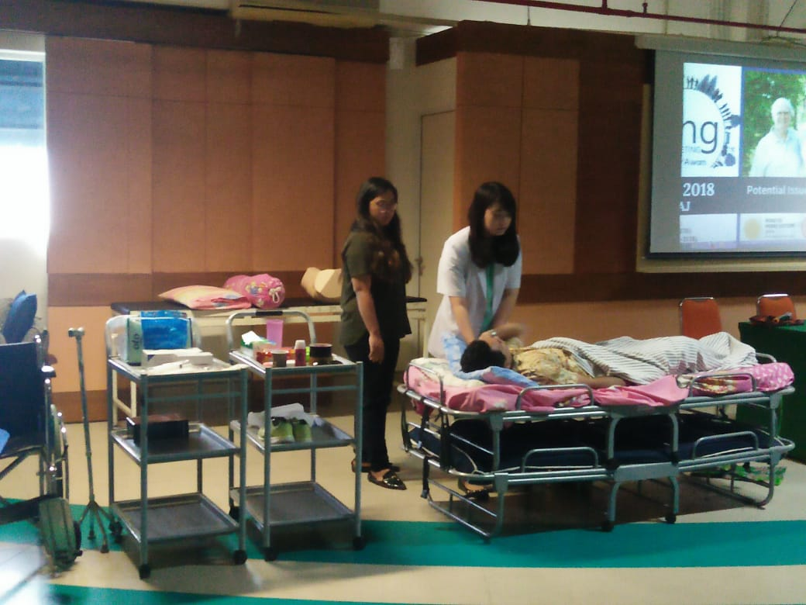

Slide 26
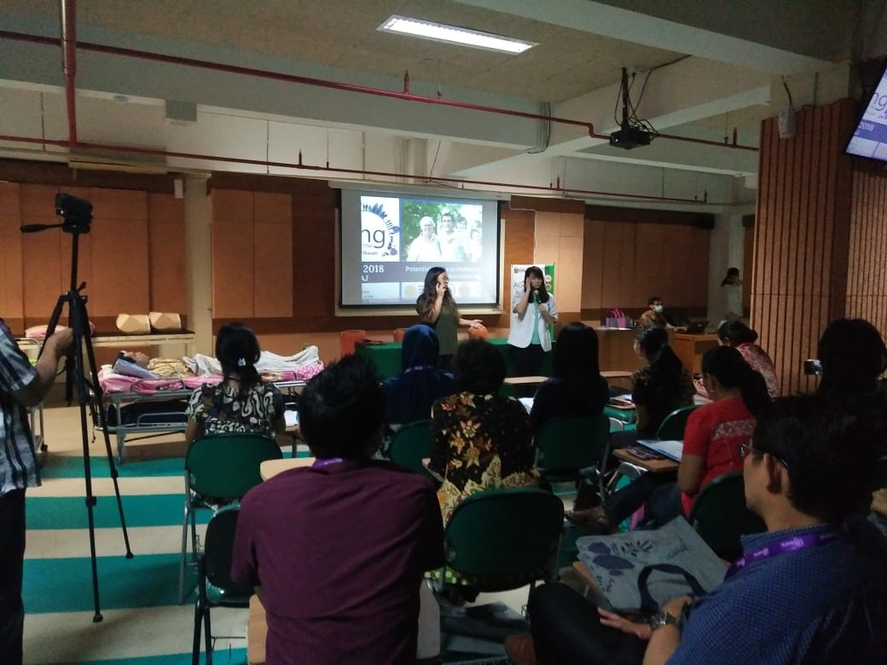

Slide 27
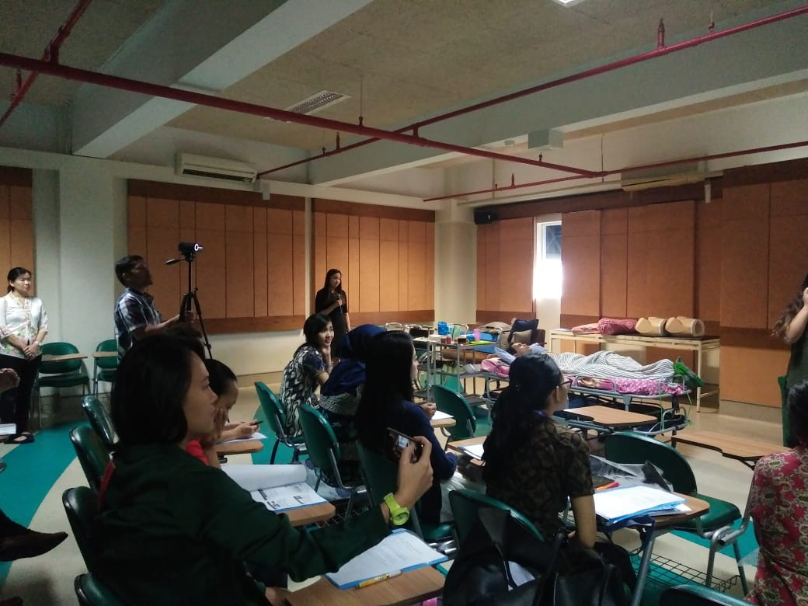

Slide 28
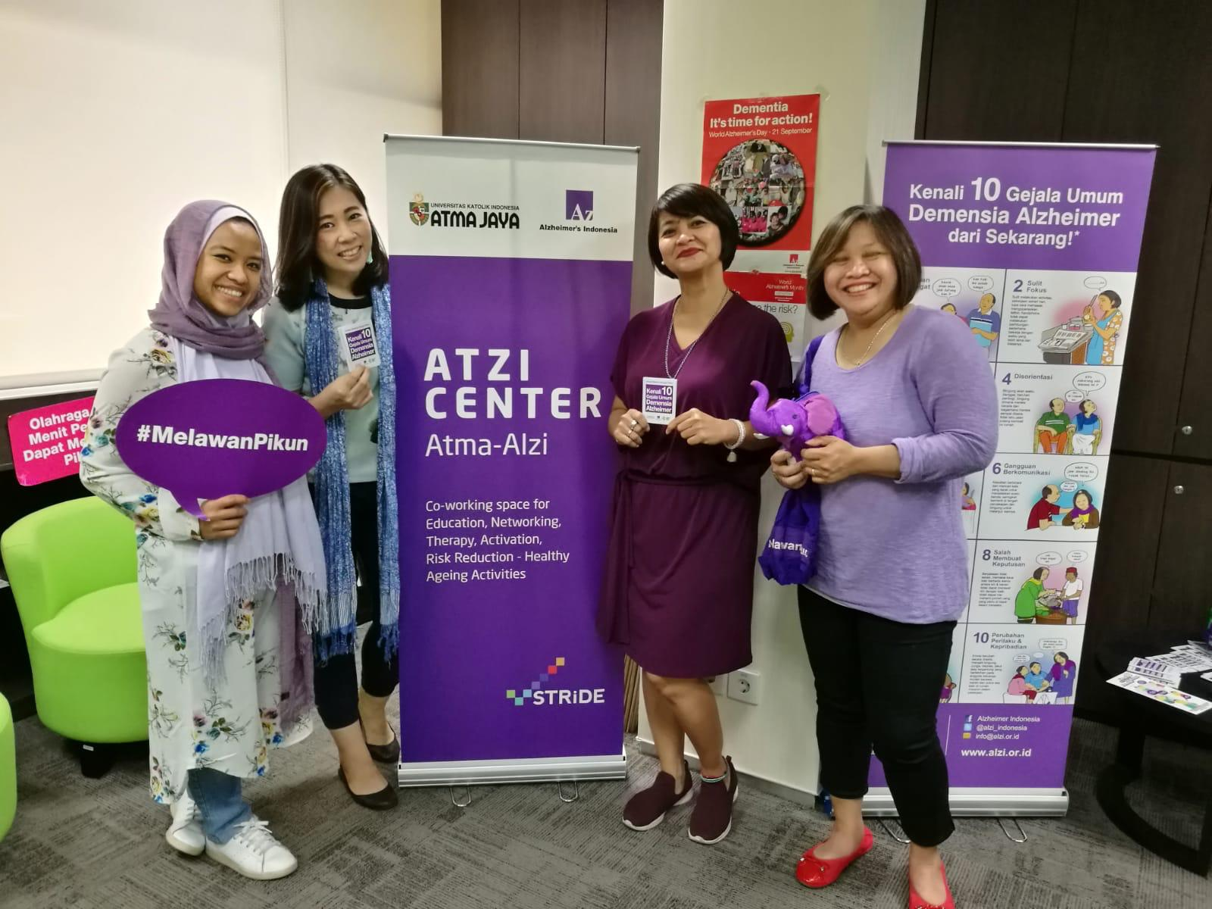
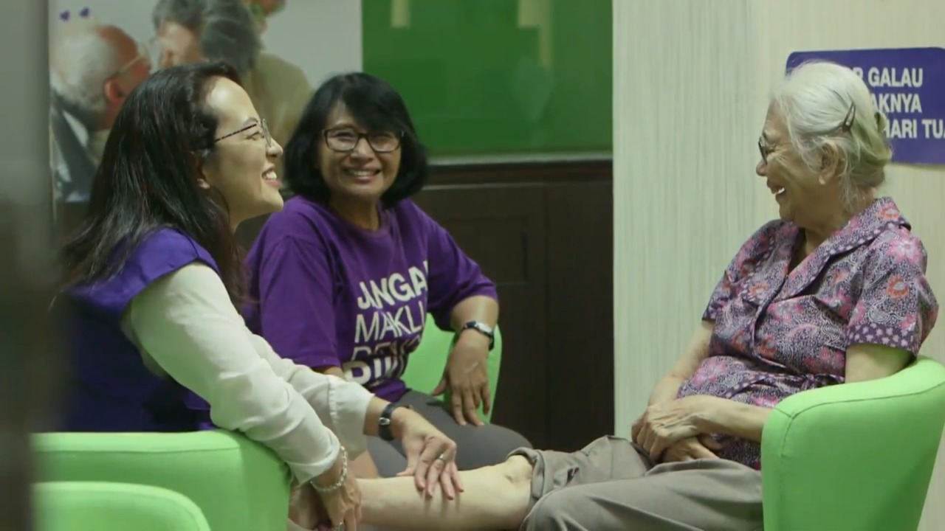
Gain NGO work experience by volunteering with
Alzheimer’s Indonesia (ALZI)
Intergenerational NGO-based community working on dementia in Indonesia

Slide 29
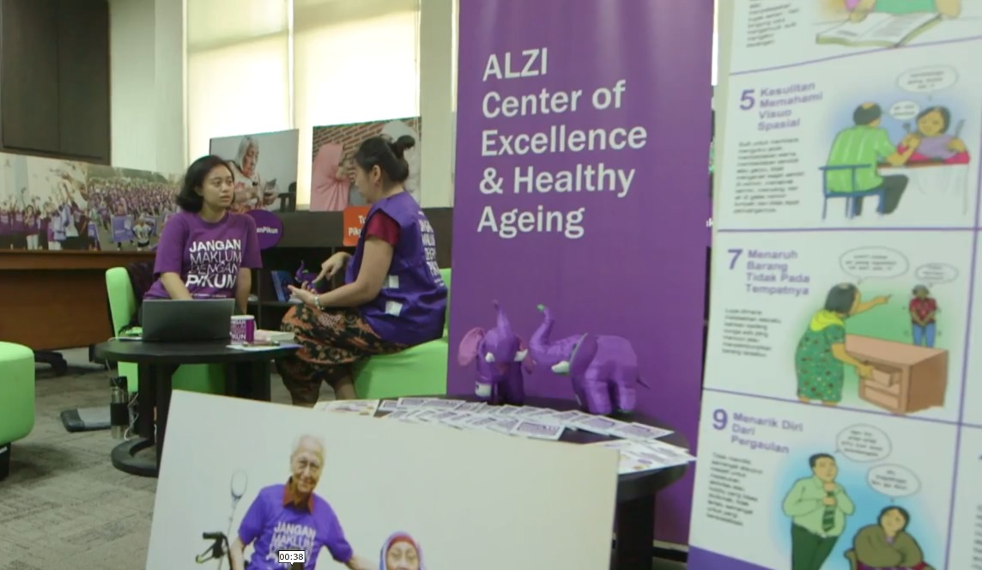
ALZI-Atma Centre

